Slide 1

Chapter 3 The Study of Hair
By the end of this chapter you will be able to:
Identify the various parts of a hair
Describe variations in the structure of the medulla, cortex, and cuticle
Distinguish between human and nonhuman hair
Determine if two examples of hair are from the same person
Explain how hair can be used in a forensic investigation
Calculate the medullary index for a hair
Perform microscopic analysis using proper microscope usage and storage.
All Rights Reserved South-Western / Cengage Learning © 2012, 2009
Forensic Science: Fundamentals & Investigations, Chapter 3

Slide 2
History of Hair Analysis
1883: Alfred Swaine Taylor and Thomas Stevenson covered hair in a forensic science text
1910: Victor Balthazard and Marcelle Lambert published a comprehensive study of hair
1934: Dr. Sydney Smith, analyzed hairs side by side
Today: chemical tests, neutron activation analysis, and DNA analysis
Forensic Science: Fundamentals & Investigations, Chapter 3

Slide 3
Hair Basics
Hair functions to regulate temperature, reduce friction, protect from light, and produce sensory data.
Hair consists of a hair shaft produced by a follicle embedded in the skin.
Forensic Science: Fundamentals & Investigations, Chapter 3

Slide 4
Biology of Hair
Hair is composed of the protein keratin, which is also the primary component of finger and toe nails.
Hair is produced from a structure called the hair follicle. Humans develop hair follicles during fetal development, and no new follicles are produced after birth.
Hair color is mostly the result of pigments, which are chemical compounds that reflect certain wavelengths of visible light.
Sources: http://library.thinkquest.org/04oct/00206/lesson.htm#t_hair & http://www.fbi.gov/hq/lab/fsc/backissu/july2000/deedric1.htm#Index%20(Hairs)

Slide 5
Hair Structure
Hair is composed of three principal parts:
Cuticle – outer coating composed of overlapping scales
Cortex – protein-rich structure around the medulla that contains pigment
Medulla – central core
(may be absent)
The structure of hair has been compared to that of a pencil with the medulla being the lead, the cortex being the wood and the cuticle being the paint on the outside.
http://library.thinkquest.org/04oct/00206/lesson.htm#t_hair

Slide 6
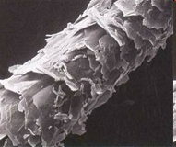
Hair Structure
Cuticle: outermost layer
The cuticle varies in:
  Its scales
  Its thickness, and
  Whether or not it contains pigment.
Info: http://library.thinkquest.org/04oct/00206/lesson.htm#t_hair Image: http://www.hairdressersus.com/micro/Image5b.jpg

Slide 7



Animal Hair
and Human Hair
Spinous Coronal Imbricate
Animals: cuticle scales resemble petals (spinous) or a stack of crowns (coronal)
Humans: commonly flattened and narrow (imbricate)
Forensic Science: Fundamentals & Investigations, Chapter 3

Slide 8
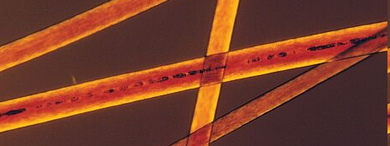
Hair Structure
Cortex
The cortex varies in:
  Thickness
  Color (pigment)
Distribution of the cortex is perhaps the most important component in determining from which individual a human hair may have come.
Info: http://library.thinkquest.org/04oct/00206/lesson.htm#t_hair Image: http://www.extrapersonality.com/hair.html

Slide 9
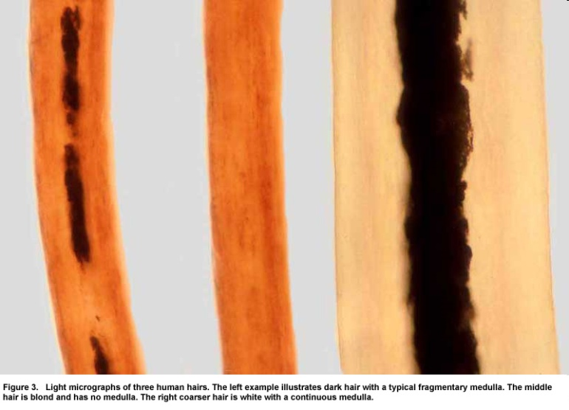

Hair Structure
Medulla
The medulla may vary in:
  Thickness
  Continuity - one continuous structure
  or broken into pieces
  Opacity - how much light is able to
  pass through it
It may also be absent in some species.
Like the cuticle, the medulla can be important for distinguishing between hairs of different species, but often does not lend much important information to the differentiation between hairs from different people.
http://library.thinkquest.org/04oct/00206/lesson.htm#t_hair
http://www.bfro.net/images/whatis/figures/Fig.%203%20with%20caption.jpg

Slide 10
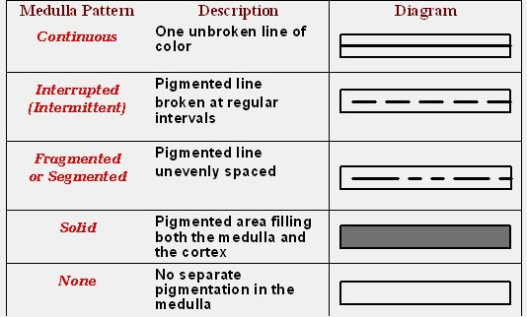
Types of Medulla
Forensic Science: Fundamentals & Investigations, Chapter 3

Slide 11
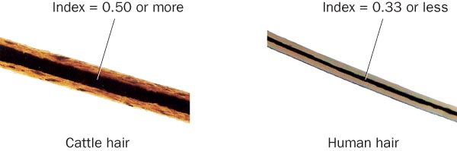
Medulla Index—
Animals vs. Humans
Forensic Science: Fundamentals & Investigations, Chapter 3

Slide 12
Types of Hair
Human hair varies on the body
  Head
  Eyebrows
  Lashes
  Mustache
  Beard
  Underarms
  Body hair
  Pubic
Forensic Science: Fundamentals & Investigations, Chapter 3

Slide 13
The Life Cycle of Hair
Hair proceeds through 3 stages as it develops:
Anagen stage:
  hair actively grows
  cells around the follicle rapidly divide and deposit materials in the hair
Catagen stage:
  hair grows and changes
Telogen stage:
  follicle becomes dormant
Forensic Science: Fundamentals & Investigations, Chapter 3

Slide 14
Treated Hair
Bleaching
  disturbs the scales on the cuticle and
  removes pigment
  leaves hair brittle and yellowish
Dyeing colors the cuticle and the cortex
Forensic Science: Fundamentals & Investigations, Chapter 3

Slide 15
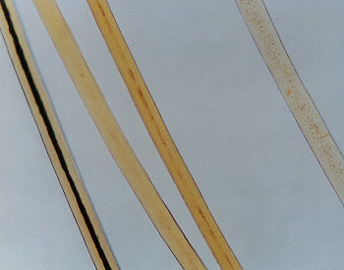

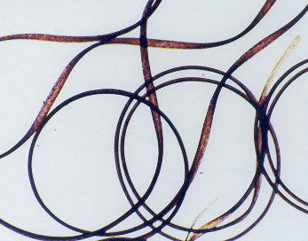
Racial
Differences
Broad, racial groups do exhibit some shared physical characteristics
But NOT applicable to all individuals in these groups
Therefore,
Individual hairs CANNOT be assigned to any of these groups
Forensic Science: Fundamentals & Investigations, Chapter 3

Slide 16

Animal Hair
and Human Hair
Pigmentation:
  animal hair is denser toward the medulla
  human hair tends to be denser toward the cuticle
Banded Color Patterns:
  possible in animals
  not in humans
Medulla: much thicker in animals
Forensic Science: Fundamentals & Investigations, Chapter 3

Slide 17
Using Hair in an
Investigation
Macroscopic investigations indicate
  Length, color, curliness
Phase contrast microscopy shows
  presence of dye or other treatments
Electron microscopes yield yet more detail
Chemical tests
  presence of various substances
Examining a hair shaft
  timeline for exposure to toxins
Neutron Activation Analysis (NAA)
  concentrations of substances
Forensic Science: Fundamentals & Investigations, Chapter 3

Slide 18
Testing the Hair Follicle
Microscopic assessment
  Cost effective and quick
Blood test
  Determine blood type
DNA analysis
  Identification with a high degree of confidence
Forensic Science: Fundamentals & Investigations, Chapter 3

